Slide 1
4. Probability Distributions
Probability: With random sampling or a randomized experiment, the probability an observation takes a particular value is the proportion of times that outcome would occur in a long sequence of observations.
Usually corresponds to a population proportion (and thus falls between 0 and 1) for some real or conceptual population.

Slide 2
Basic probability rules
Let A, B denotes possible outcomes
P(not A) = 1 – P(A)
For distinct (separate) possible outcomes A and B,
P(A or B) = P(A) + P(B)
If A and B not distinct,
P(A and B) = P(A)P(B given A)
For “independent” outcomes, P(B given A) = P(B), so P(A and B) = P(A)P(B).

Slide 3
Happiness (2008 GSS data)
Income Very Pretty Not too Total
-------------------------------
Above Aver. 164 233 26 423
Average 293 473 117 883
Below Aver. 132 383 172 687
------------------------------
Total 589 1089 315 1993
Let A = above average income, B = very happy
P(A) estimated by 423/1993 = 0.212 (a “marginal probability”),
P(not A) = 1 – P(A) = 0.788
P(B) estimated by 589/1993 = 0.296
P(B given A) estimated by 164/423 = 0.388 (a “conditional prob.”)
P(A and B) = P(A)P(B given A) estimated by 0.212(0.388) = 0.082
(which equals 164/1993, a “joint probability”)

Slide 4
P(B) = 0.296, P(B given A) = 0.388, so A and B not independent.
If A and B were independent, then
P(A and B) = P(A)P(B) = 0.212(0.296) = 0.063
But, P(A and B) = 0.082.
Inference questions: In this sample, A and B are not independent, but can we infer anything about whether events involving happiness and events involving family income are independent (or dependent) in the population?
If dependent, what is the nature of the dependence?
(does higher income tend to go with higher happiness?)

Slide 5
Success of New England Patriots
Before season, suppose we let
A1 = win game 1
A2 = win game 2, … , A16 = win game 16
If Las Vegas odds makers predict P(A1) = 0.55, P(A2) = 0.45, then P(A1 and A2) = P(win both games) = (0.55)(0.45) = 0.2475, if outcomes independent
If P(A1) = P(A2) = … = P(A16) = 0.50 and indep.
(like flipping a coin), then
P(A1 and A2 and A3 … and A16) = P(win all 16 games)
= (0.50)(0.50)…(0.50) = (0.50)¹⁶ = 0.000015.

Slide 6
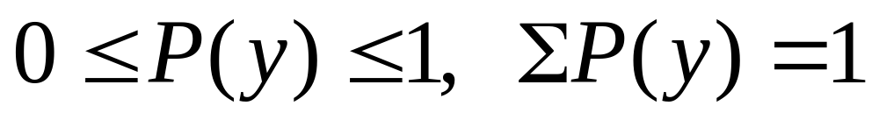
Probability distribution of a variable
Lists the possible outcomes for the “random variable” and their probabilities
Discrete variable:
Assign probabilities P(y) to individual values y, with

Slide 7
Example: Randomly sample 3 people and ask whether they favor (F) or oppose (O) legalization of same-sex marriage
y = number who “favor” (0, 1, 2, or 3)
For possible samples of size n = 3,
Sample y Sample y
(O, O, O) 0 (O, F, F) 2
(O, O, F) 1 (F, O, F) 2
(O, F, O) 1 (F, F, O) 2
(F, O, O) 1 (F, F, F) 3

Slide 8
If population equally split between F and O, these eight samples are equally likely.
Probability distribution of y is then
y P(y)
0 1/8
1 3/8
2 3/8
3 1/8
(special case of “binomial distribution,” introduced in Chap. 6). In practice, probability distributions are often estimated from sample data, and then have the form of frequency distributions

Slide 9
Probability distribution for y = happiness (estimated from GSS)
Outcome y Probability
Very happy 0.30
Pretty happy 0.54
Not too happy 0.16

Slide 10
Example: GSS results on y = number of people you knew personally who committed suicide in past 12 months (variable “suiknew”).
Estimated probability distribution is
y P(y)
0 .895
1 .084
2 .015
3 .006

Slide 11
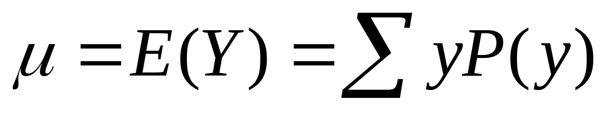
Like frequency distributions, probability distributions have descriptive measures, such as mean and standard deviation
Mean (expected value) -
µ = 0(0.895) + 1(0.084) + 2(0.015) + 3 (0.006) = 0.13
represents a “long run average outcome”
(median = mode = 0)

Slide 12
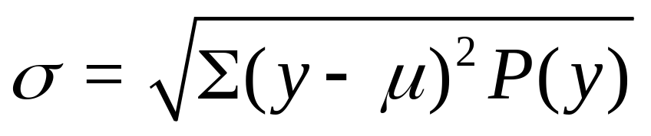
Standard Deviation - Measure of the “typical” distance of an outcome from the mean, denoted by σ
(We won’t need to calculate this formula.)
If a distribution is approximately bell-shaped, then:
all or nearly all the distribution falls between
µ - 3σ and µ + 3σ
Probability about 0.68 (0.95) falls between
µ - σ and µ + σ (µ - 2σ and µ + 2σ)

Slide 13
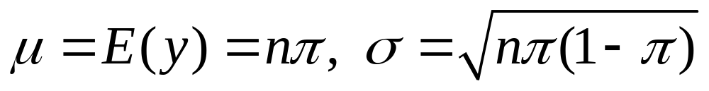
Example: From result later in chapter, if n people are randomly selected from population with proportion  favoring legal same-sex marriage (1-, Oppose), then
y = number in sample who favor it
has a bell-shaped probability distribution with
e.g, with n = 1000,  = 0.50, we obtain µ = 500, σ = 16
Nearly all the distribution falls between about
500 – 3(16) = 452 and 500 + 3(16) = 548
i.e., almost certainly between about 45% and 55% of the sample will say they favor legal same-sex marriage

Slide 14
Continuous variables:
Probabilities assigned to intervals of numbers
Ex. When y takes lots of values, as in last example, it is continuous for practical purposes. Then, if probability distribution is approx. bell-shaped,
Most important probability distribution for continuous variables is the normal distribution

Slide 15
Normal distribution
Symmetric, bell-shaped (formula in Exercise 4.56)
Characterized by mean (μ) and standard deviation (σ), representing center and spread
Probability within any particular number of standard deviations of μ is same for all normal distributions
An individual observation from an approximately normal distribution has probability
  0.68 of falling within 1 standard deviation of mean
  0.95 of falling within 2 standard deviations
  0.997 of falling within 3 standard deviations

Slide 16
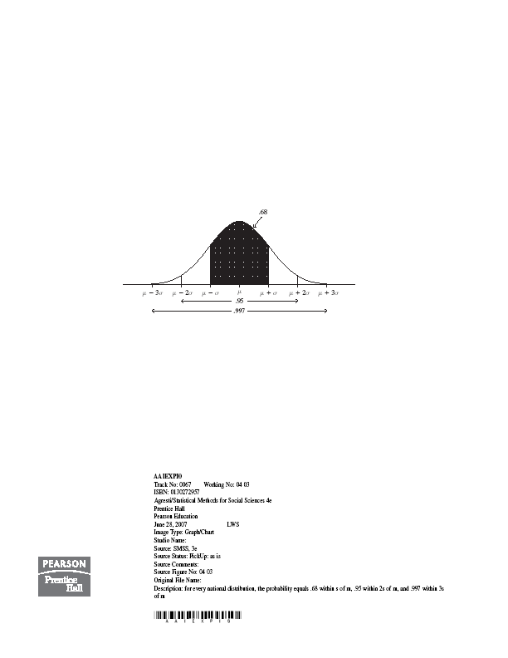

Slide 17
Table A (p. 592 and inside back cover of text)
gives probability in right tail above µ + zσ for various values of z.
Second Decimal Place of z
z .00 .01 .02 .03 .04 .05 .06 .07 .08 .09
0.0 .5000 .4960 .4920 .4880 .4840 .4801 .4761 .4721 .4681 .4641
…
….
1.4 .0808 .0793 .0778 .0764 .0749 .0735 .0722 .0708 .0694 .0681
1.5 .0668 .0655 .0643 .0630 .0618 .0606 .0594 .0582 .0571 .0559
…….
……..

Slide 18
Example: What is probability falling between
µ - 1.50σ and µ + 1.50σ ?
z = 1.50 has right tail probability = 0.0668
Left tail probability = 0.0668 by symmetry
Two-tail probability = 2(0.0668) = 0.1336
Probability within µ - 1.50σ and µ + 1.50σ is
1 – 0.1336 = 0.87
Example: z = 2.0 gives
two-tail prob. = 2(0.0228) = 0.046,
probability within µ ± 2σ is 1 - 0.046 = 0.954

Slide 19
Example: What z-score corresponds to 99th percentile (i.e., µ + zσ = 99th percentile)?
Right tail probability = 0.01 has z = 2.33
99% falls below µ + 2.33σ
If IQ has µ = 100, σ = 16, then 99th percentile is
µ + 2.33σ = 100 + 2.33(16) = 137
Note: µ - 2.33σ = 100 – 2.33(16) = 63 is 1st percentile
0.98 = probability that IQ falls between 63 and 137

Slide 20
Example: What is z so that µ ± zσ encloses exactly 95% of normal curve?
Total probability in two tails = 0.05
Probability in right tail = 0.05/2 = 0.025
z = 1.96
µ ± 1.96σ contains probability 0.950
(µ ± 2σ contains probability 0.954)
Exercise: Try this for 99%, 90%
(should get 2.58, 1.64)

Slide 21
Example: Minnesota Multiphasic Personality Inventory (MMPI), based on responses to 500 true/false questions, provides scores for several scales (e.g., depression, anxiety, substance abuse), with
µ = 50, σ = 10.
If distribution is normal and score of ≥ 65 is considered abnormally high, what percentage is this?
z = (65 - 50)/10 = 1.50
Right tail probability = 0.067 (less than 7%)

Slide 22
Notes about z-scores
z-score represents number of standard deviations that a value falls from mean of dist.
A value y is z = (y - µ)/σ
standard deviations from µ
Example: y = 65, µ = 50, σ = 10
z = (y - µ)/σ = (65 – 50)/10 = 1.5
The z-score is negative when y falls below µ
(e.g., y = 35 has z = -1.5)

Slide 23
The standard normal distribution
is the normal distribution with µ = 0, σ = 1
For that distribution, z = (y - µ)/σ = (y - 0)/1 = y
i.e., original score = z-score
µ + zσ = 0 + z(1) = z
(we use standard normal for statistical inference starting in Chapter 6, where certain statistics are scaled to have a standard normal distribution)
Why is normal distribution so important?
We’ll learn today that if different studies take random samples and calculate a statistic (e.g. sample mean) to estimate a parameter (e.g. population mean), the collection of statistic values from those studies usually has approximately a normal distribution. (So?)

Slide 24
A sampling distribution lists the possible values of a statistic (e.g., sample mean or sample proportion) and their probabilities
Example: y = 1 if favor legalized same-sex marriage
y = 0 if oppose
For possible samples of size n = 3, consider sample mean
Sample Mean Sample Mean
(1, 1, 1) 1.0 (1, 0, 0 ) 1/3
(1, 1, 0) 2/3 (0, 1, 0) 1/3
(1, 0, 1) 2/3 (0, 0, 1) 1/3
(0, 1, 1) 2/3 (0, 0, 0) 0

Slide 25
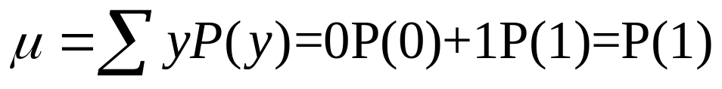
For binary data (0, 1), sample mean equals sample proportion of “1” cases. For population,
is population proportion of “1” cases
(e.g., favoring legal same-sex marriage)
How close is sample mean to population mean µ?
To answer this, we must be able to answer,
“What is the probability distribution of the sample mean?”

Slide 26
Sampling distribution of a statistic is the probability distribution for the possible values of the statistic
Ex. Suppose P(0) = P(1) = ½. For random sample of size n = 3, each of 8 possible samples is equally likely. Sampling distribution of sample proportion is
Sample proportion Probability
0 1/8
1/3 3/8
2/3 3/8
1 1/8 (Try for n = 4)

Slide 27
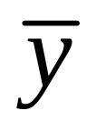
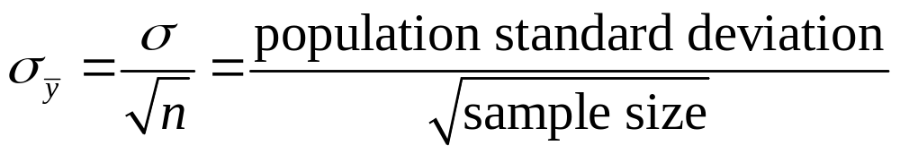
Sampling distribution of sample mean
is a variable, its value varying from sample to sample about the population mean µ
Standard deviation of sampling distribution of is called the standard error of
For random sampling, the sampling distribution of
has mean µ and standard error

Slide 28
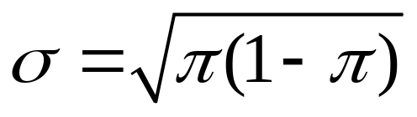

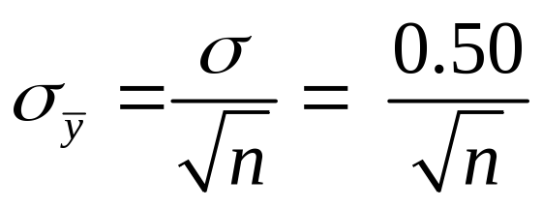
Example: For binary data (y =1 or 0) with
P(Y=1) =  (with 0 <  < 1), can show that
(Exercise 4.55b, and special case
of earlier formula on p. 13 of these notes with n = 1)
When  = 0.50, then = 0.50, and standard error is
n standard error
.289
100 .050
200 .035
1000 .016

Slide 29

Note standard error goes down as n goes up
(i.e., tends to fall closer to µ)
With n = 1000, standard error = 0.016, so if the sampling distribution is bell-shaped, the sample proportion almost certainly falls within 3(0.016) = 0.05 of population proportion of 0.50
(i.e., between about 0.45 and 0.55)
Number of times y = 1 (i.e., number of people in favor) is 1000 (proportion), so that the “count” variable has
mean = 1000(0.50) = 500
std. dev. 1000(0.016) = 16 (as in earlier ex. on p. 13)

Slide 30
Practical implication: This chapter presents theoretical results about spread (and shape) of sampling distributions, but it implies how different studies on the same topic can vary from study to study in practice (and therefore how precise any one study will tend to be)
Ex. You plan to sample 1000 people to estimate the population proportion supporting Obama’s health care plan. Other people could be doing the same thing. How will the results vary among studies (and how precise are your results)?
The sampling distribution of the sample proportion in favor of the health care plan has standard error describing the likely variability from study to study.

Slide 31
Ex. Many studies each take sample of n = 1000 to estimate population proportion
We’ve seen the sample proportion should vary from study to study around 0.50 with standard error = 0.016
Flipping a coin 1000 times simulates the process when the population proportion = 0.50.
We can verify this empirically, by simulating using the “sampling distribution” applet at
www.prenhall.com/agresti
Shape? Roughly bell-shaped. Why?

Slide 32
Central Limit Theorem: For random sampling with “large” n, the sampling dist. of the sample mean is approximately a normal distribution
Approximate normality applies no matter what the shape of the population dist. (Figure p. 93, next page)
With the applet, you can test this out using various population shapes, including “custom”
How “large” n needs to be depends on skew of population distribution, but usually n ≥ 30 sufficient

Slide 33
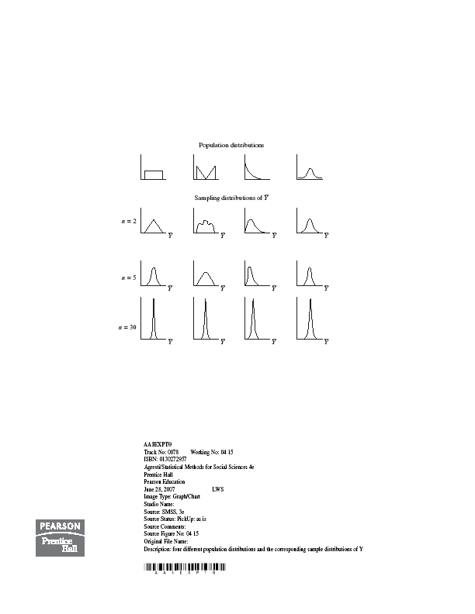

Slide 34
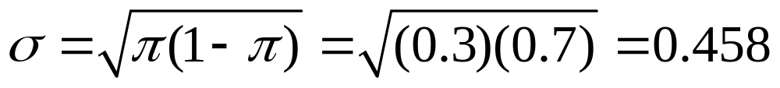

Example: You plan to randomly sample 100 Harvard students to estimate population proportion who have participated in “binge drinking.” Find probability your sample proportion falls within 0.04 of population proportion, if that population proportion = 0.30
(i.e., between 0.26 and 0.34)
y = 1, yes y = 0, no
µ = = 0.30,
By CLT, sampling distribution of sample mean (which is the proportion “yes”) is approx. normal with mean 0.30,
standard error =

Slide 35
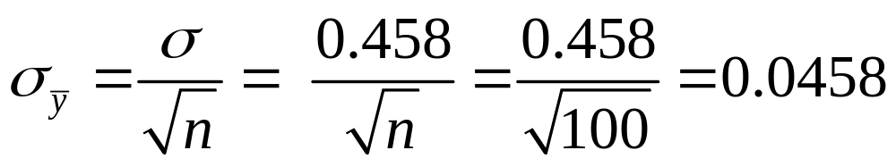
0.26 has z-score z = (0.26 - 0.30)/0.0458 = -0.87
0.34 has z-score z = (0.34 - 0.30)/0.0458 = 0.87
P(sample mean ≥ 0.34) = 0.19
P(sample mean ≤ 0.26) = 0.19
P(0.26 ≤ sample mean ≤ 0.34) = 1 – 2(0.19) = 0.62
The probability is 0.62 that the sample proportion will fall within 0.04 of the population proportion
How would this change if n is larger (e.g., 200)?

Slide 36
But, don’t be “fooled by randomness”
We’ve seen that some things are quite predictable (e.g., how close a sample mean falls to a population mean, for a given n)
But, in the short term, randomness is not as “regular” as you might expect (I can usually predict who “faked” coin flipping.)
In 200 flips of a fair coin,
P(longest streak of consecutive H’s < 5) = 0.03
The probability distribution of longest streak has µ = 7
Implications: sports (win/loss, individual success/failure)
stock market up or down from day to day, ….

Slide 37
Some Summary Comments
Consequence of CLT: When the value of a variable is a result of averaging many individual influences, no one dominating, the distribution is approx. normal (e.g., IQ, blood pressure)
In practice, we don’t know µ, but we can use spread of sampling distribution as basis of inference for unknown parameter value
(we’ll see how in next two chapters)
We have now discussed three types of distributions:

Slide 38
Population distribution – described by parameters such as µ, σ (usually unknown)
Sample data distribution – described by sample statistics such as
sample mean , standard deviation s
Sampling distribution – probability distribution for possible values of a sample statistic; determines probability that statistic falls within certain distance of population parameter
(graphic showing differences)

Slide 39
Ex. (categorical): Poll about health care
Statistic = sample proportion favoring the new health care plan
What is (1) population distribution, (2) sample distribution, (3) sampling distribution?
Ex. (quantitative): Experiment about impact of cell-phone use on reaction times
Statistic = sample mean reaction time
What is (1) population distribution, (2) sample distribution, (3) sampling distribution?

Slide 40
By the Central Limit Theorem (multiple choice)
All variables have approximately normal sample data distributions if a random sample has at least 30 observations
Population distributions are normal whenever the population size is large (at least about 30)
For large random samples, the sampling distribution of the sample mean is approximately normal, regardless of the shape of the population distribution
The sampling distribution looks more like the population distribution as the sample size increases
All of the above

